Slide 1
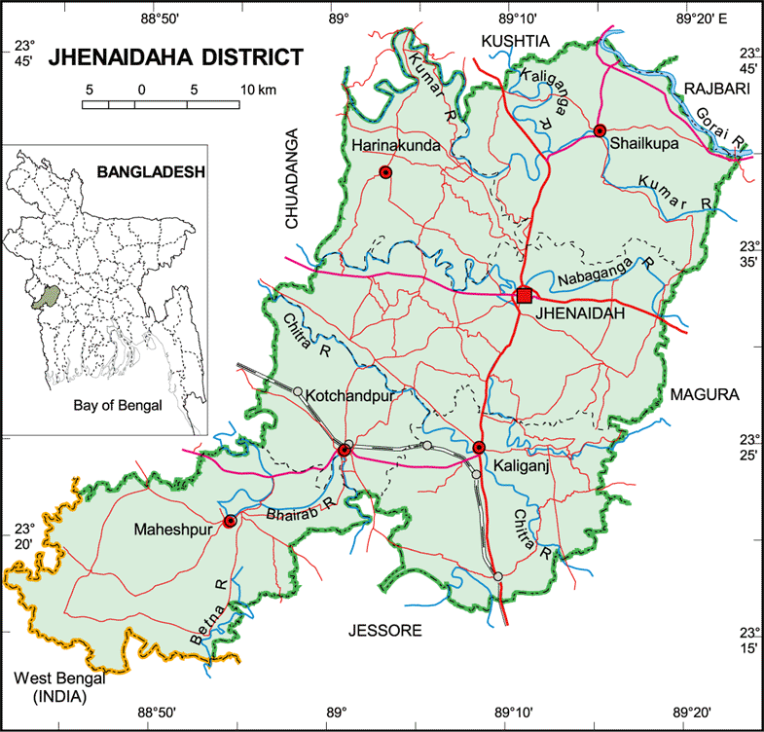
Welcome to Jhenaidah District

Slide 2
Participant from Jhenaidah
Sl No | Name | Designation
01 | Saidul Karim Mintu | Mayor, Jhenaidah Municipality
02 | Dr. Abdur Rahman | Jhenaidah, Hospital
03 | Dr. Emdad | Jhenaidah, Hospital
04 | Joya Rani Chanda | Principal, Fazar Ali Girls School and College
05 | Suraya Begum | Game Teacher, Fazar Ali Girls School and College
06 | Lina Nasrin | Nursing Instructor, Jhenaidah
07 | Saraswati Rani Roy | Nursing Superintedent, Jhenaidah
08 | Saad Ahmed | Heath Assistant, Jhenaidah Municipality
09 | Protap Biswas | NGO Worker
10 | Umme Sayma Joya | Social Worker
11 | Md. Ruhul Amin Munshi | City Coordinator, FSM programme,SNV
12 | Kazol Biswas | Social Worker
13 | Md. Jalil | Reporter
14 | Sazzadul Islam Sazzad | Reporter, Amader Somoy, Jhenaidah
15 | Mahmud Hasan Tipu | Reporter, Samokal, Vice President , Jheniadah Press Club
16 | Amit Kumar Das | Social Worker

Slide 3
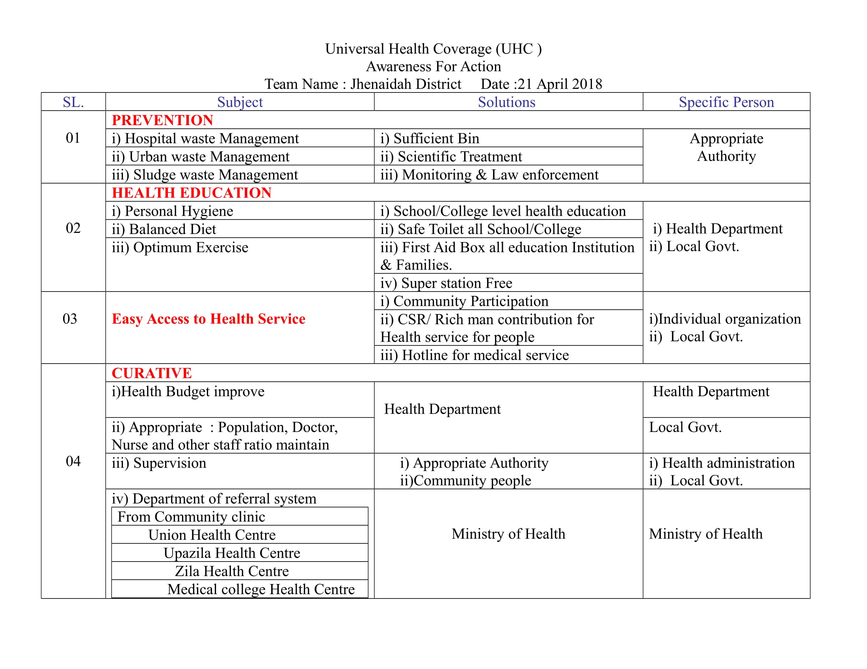
Team Jhenaidah

Slide 4
Health Democracy:
Health Governance
Health Accountability
People Empowerment

Slide 5
Thank you

